Slide 1
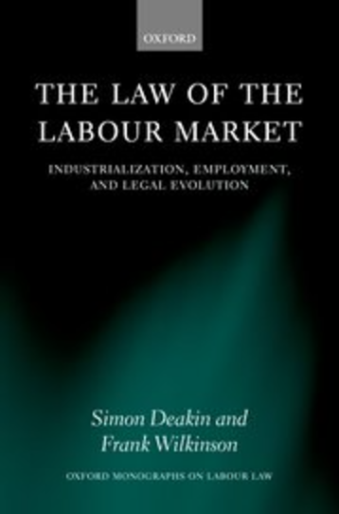
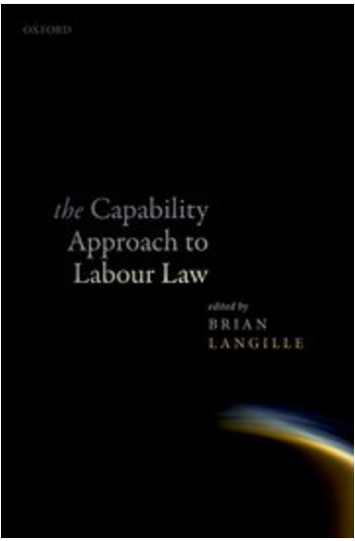
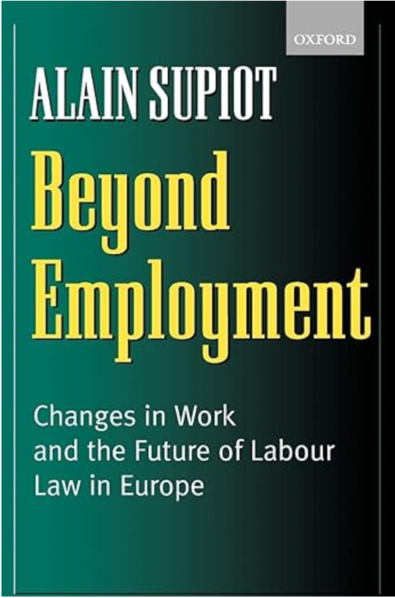
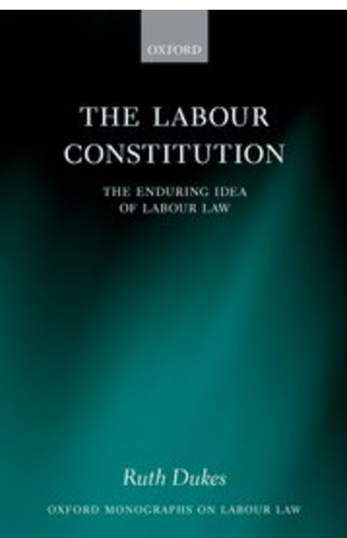

Slide 2
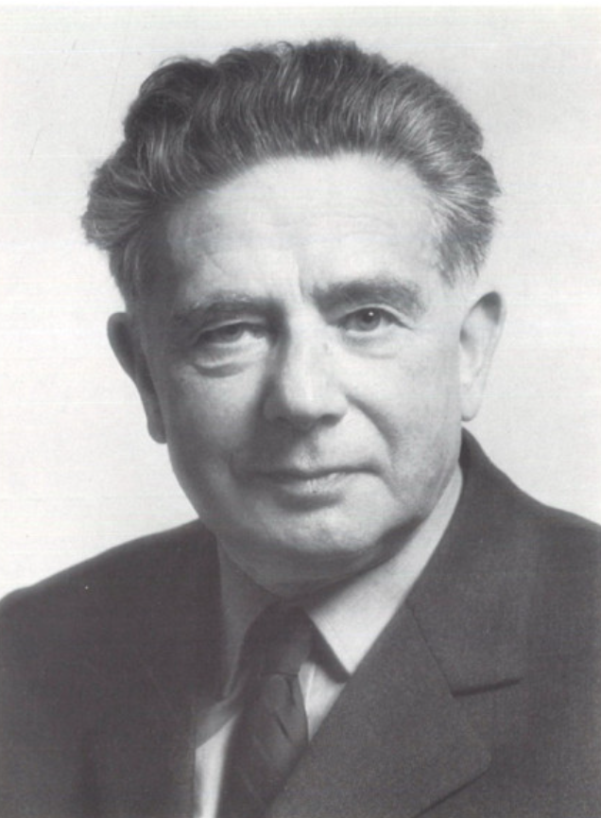
Otto Kahn-Freund (1900-1979)

Slide 3
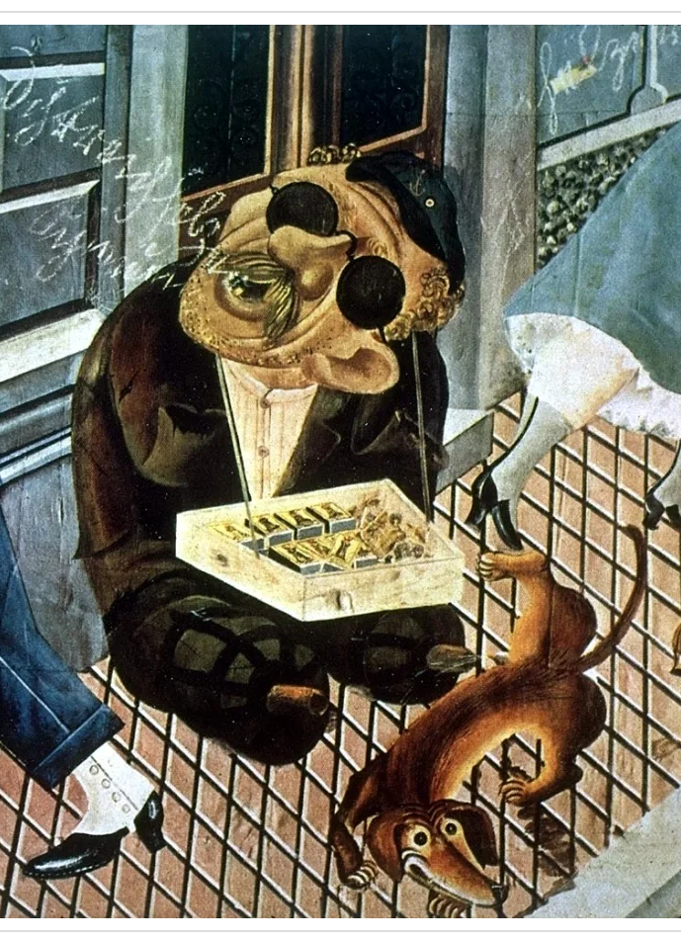
Collectivism as the central principle of Weimar labour law
‘The Social Ideal of the Reich Labour Court’; ‘The Changing Function of Labour Law’
‘an instrument to assist the rise of the suppressed class’ >> ‘an instrument of the state to suppress class contradictions’
‘The legal system … attempts, within the framework of the capitalist system, to determine the way the class struggle is conducted by the establishment of legal norms and, over and above this, to utilise the results of each individual stage of conflict for the further development of the law.’
Class conflict, collectivism, freedom

Slide 4
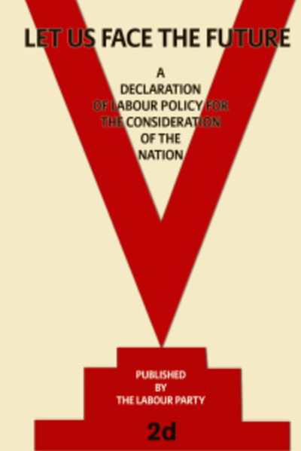
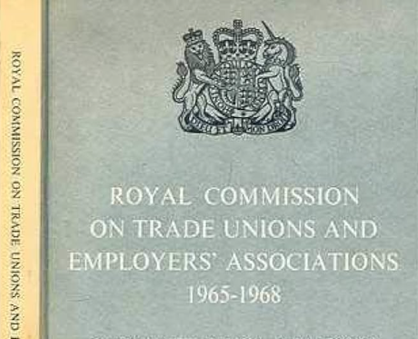
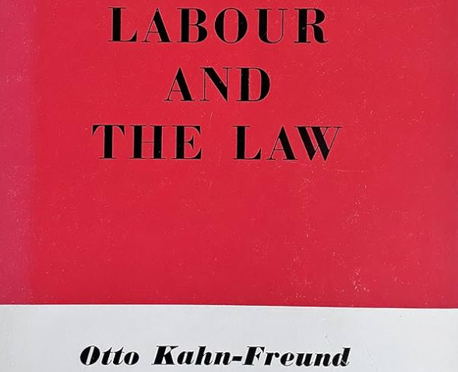
English Labour Law 1950s-1970s
Collective laissez-faire: labour law facilitates and supports the collectivization of labour and prescribes ‘Queensbury Rules’
Conflicts of interest between labour and management over wages and other terms and conditions
Such conflicts can be periodically adjusted through ‘give and take’

Slide 5
A post-Hayekian theory of labour law?
‘There is now ... a challenge to those who do not accept [neoliberal orthodoxies] on law and the labour market, who continue to assert the value of free and effective association, affirming both the need for collective combination as a condition of freedom for employed individuals and the right to organise together in protection of their occupational interests and against exploitation in a pluralist democracy. If they hold that the concept of ‘social justice’ is not wholly meaningless, they will also refuse to accept that the limitations on human knowledge, real though they undoubtedly are, preclude all possibility of managing a free society in the general interest. Yet, thrown into confusion by the newly dominant philosophy, they have found that their old arguments will not do.’
Lord Wedderburn, 1989

Slide 6
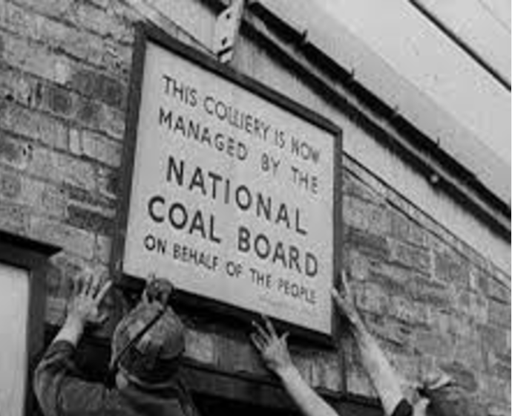
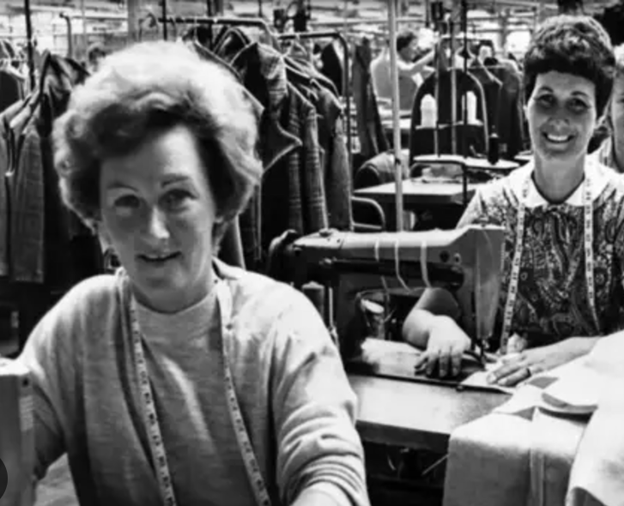
Conflict and consensus in historical context
Collective laissez-faire supported by a political and economic context that was geographically bounded and historically exceptional
Postwar retreat of capitalism across the social sciences
From 1980s, dominance of neoliberal thinking creates need to ‘bring capitalism back in’ (Wolfgang Streeck)
Renewed preference for approaches that centre class conflict and politics? eg LPE

Slide 7
Thanks for listening!
R Dukes, The Labour Constitution: the Enduring Idea of Labour Law (Oxford University Press 2014)
R Dukes and W Streeck, Democracy at Work: Contract Status and Post-Industrial Justice (Polity Press 2023)
R Dukes, ‘The politics of method in the field of labour law’ in M Bartl et al (eds), The Politics of European Legal Research: Behind the Method (Edward Elgar 2022)
R Dukes, ‘The economic sociology of labour law’ (2019) 46(3) Journal of Law and Society 396-422.

