Slide 1
Human Development in Practice: Lessons from 40 years Experience
Frances Stewart

Slide 2
Lecture
Brief account of origins of HD
What it is
Progress over past decades
How to define progress
Broad progress for all countries
Relationship with economic growth
Characteristics of success/failure at country level
Some country stories
Conclusions and issues for future

Slide 3
Evolution of ideas on development
Growth approach following second world war and independence; raise investment; import substitution and plan for industrialisation.
Successful, but flawed:
‘rapid growth at the national level does not reduce poverty or inequality or provide sufficient productive employment’ (ILO).
Basic deficiencies of GNP focus.
Neglects income distribution.
Consistent with high and rising poverty.
Neglects environment.
Neglects ‘agency’ goals.

Slide 4
Alternative approaches
Human centred approaches developed in 1970s
Employment
Redistribution with growth
Basic Needs
Capabilities
1980s: debt crisis, stabilisation
Human goals displaced.
1990 Human Development Report, drawing on Basic Needs and capabilities

Slide 5
What is Human Development: First Human Development Report
‘Human development is a process of enlarging people’s choices. The most critical ones are to lead a long and healthy life, to be educated and to enjoy a decent standard of living. Additional choices include political freedom, guaranteed human rights and self-respect’
‘The basic objective of development is to create an enabling environment for people to live long, healthy and creative lives’
Kant: ‘so act as to treat humanity, whether in their own person or that of any other, in every case as an end withal, never as a means only’

Slide 6
HD goes well beyond material aspects
Includes political freedoms and participation
Freedom from insecurity of many types
Freedom to enjoy cultural diversity
Community wellbeing
Social relations
Environment
Justice

Slide 7
Measurement of HD
Basic aspects measured by HDI:
education (years of schooling);
health (life expectancy)
Income per head, adjusted (PPP, logged).
Research shows ‘non-HDI’ dimensions (‘beyond the HDI) not well correlated with HDI
Therefore need to assess progress on broader dimensions as well as HDI.

Slide 9
Major progress on all three dimensions of HDI since 1960s
Life expectancy 1950 to 2012:
Africa, 36 to 58
Asia, 42 to 70
LA, 56 to 74.
Education:
Low-income countries, 50% to 100% primary; 14 to 57% sec.
Mid-income, 16% to 77% secondary
Per capita incomes 1975-2014:
low income countries rose by 100%
mid-income countries by 150%
High income countries by 75%

Slide 10
Progress accelerated in low HDI in 2000s

Slide 11
Progress on political freedom 1984-2004, but halted in 2000s

Slide 12
Trends in homicides, selected areas and countries: major contrast across continents and among countries

Slide 14
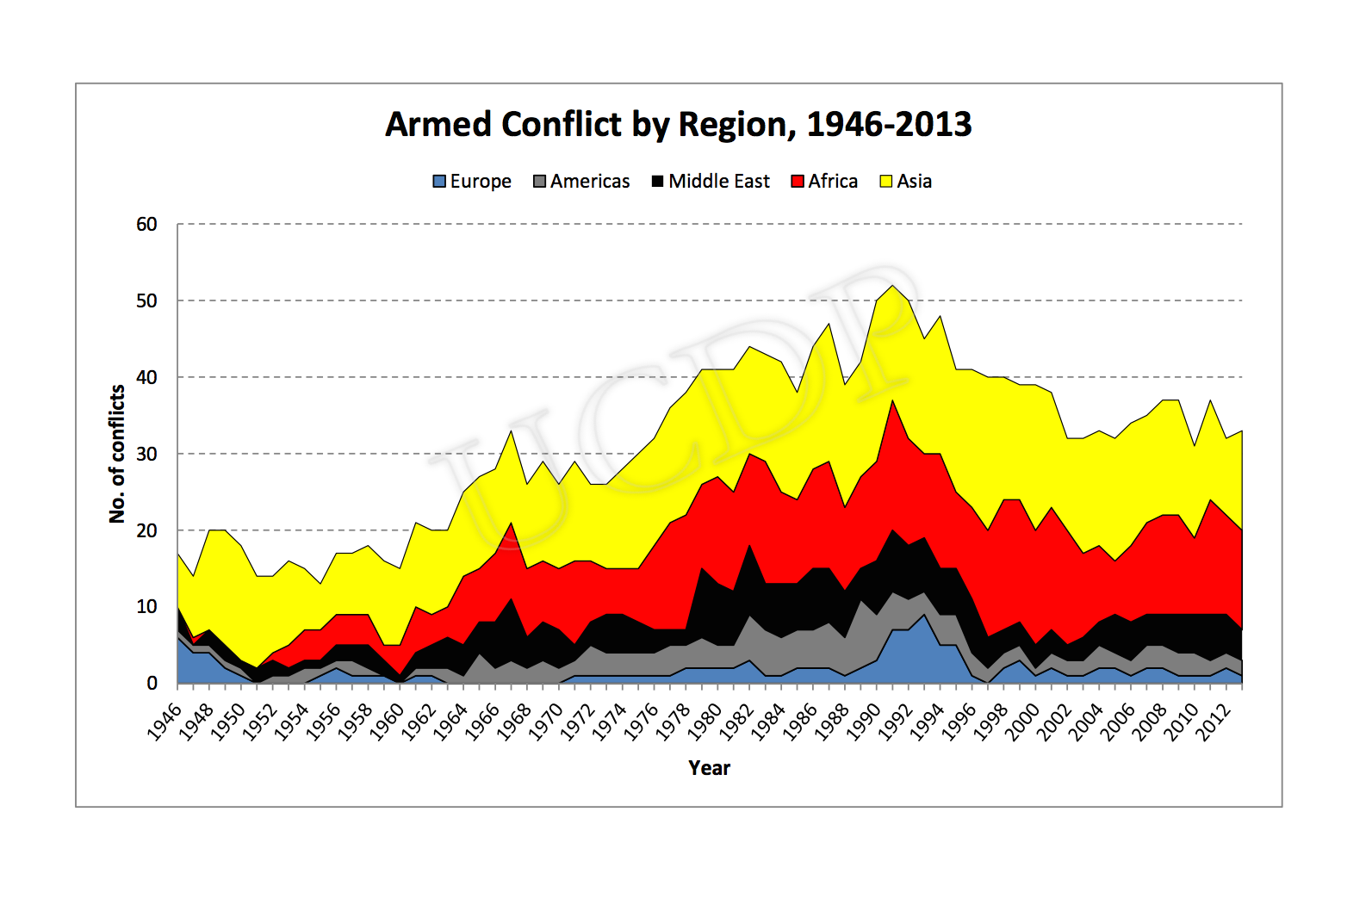

Slide 15
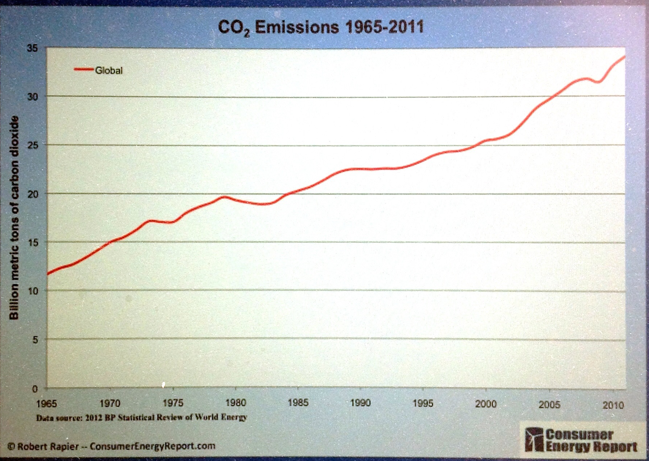

Slide 16
Growth and HD: strong connections
Growth feeds into promotion of HD via social and private expenditure, depending on how high government expenditure is and how it is distributed, and on distribution of household incomes.
Good HD feeds into growth because healthier, better educated and better nourished people are more productive.

Slide 17
HUMAN DEVELOPMENT
CHAIN
B
CHAIN
A
ECONOMIC
GROWTH

Slide 18
Empirical evidence supports the two-way relationship
Hence vicious or virtuous cycles of development.
Also lop-sided possible.
Majority of countries fall into virtuous or vicious categories.

Slide 20
Movement over time and policy sequencing
No countries moved from EG-lopsided to virtuous over four decades.
Therefore cannot give priority to economic growth and leave HD for later.
Must work simultaneously on HD improvement and growth, or put HD first.
Opposite of normal adjustment policies.

Slide 21
Exploring country experience: Examples of successful and less successful experience
Selected according to initial level of HDI:
High
Medium
Low
From 1980 because reliable data on HDI starts then.
Three (or four) countries with highest % improvement in HDI, 1980-2013, with pop. > 2m in 1980

Slide 22
High HDI countries

Slide 23
Factors we expect to be associated with success/failure on HDI on basis of econometrics
High/low social expenditure
High levels of education.
Good female to male educational enrolments
Level and growth of per capita income.
Income distribution
Poverty rates

Slide 24
Actual characteristics of good and poor performance: Social
Social expenditure:
most good performers saw large increase in S/Y, 1980-2013 (notably Saudi Arabia, Brazil and Nepal).
Large falls in some poor performers (Cote D’Ivoire, Congo, CAR), but also Iran.
Secondary education improved notably among good performers, but also in S.Africa .
Good performers improved F/M secondary ratios more than poor performers, especially low HDI.

Slide 26
Actual characteristics of good and poor performance: economic
Some good performers had v. low per capita incomes in 1980:
Korea in high HDI; China in medium; and all low HDI below poor performers.
Growth varied:
High growth and good performance – China, Korea and Nepal.
But some good countries had low/neg. growth (S.Arabia; Iran, Morocco, Mali, Cambodia)
Many poor performers had neg. growth, but some had reasonable growth – Jamaica, Phil.

Slide 28
Income distribution
Good performers mostly more equal than poor, but NOT Brazil or Mali.
And mostly improved over period, more than poor performers.
Korea, Iran, Cambodia and Mali had large improvements.
2013 most good performers Gini<0.4; most poor performers >0.4.

Slide 30
Typologies of success
All improved sec. educ and F/M ratio significantly.
Three typologies:
Growth, equity and moderate social expend.- Korea and China.
Social expenditure led, with low or negative growth and high inequality – Saudi Arabia; Brazil; Morocco.
Growth, equity and social expenditure – Turkey, Nepal and recent experience in Cambodia.

Slide 31
Accounting for poor performance
Weak social expenditure and negative growth: Congo; CAR, DRC.
Good social exp. But negative and inequitable growth: S.Africa, Togo.
Good social exp. And positive but inequitable growth. Jamaica and Philippines.

Slide 32
Beyond the HDI: Political freedom not necessary for success

Slide 33
Non-HDI dimensions
Better performers mostly show less gender inequality (UNDP index)
Less homicides, with exception of Brazil
No civil conflict among good high HDI; but significant incidence among medium and low HDI:
good performers --. Nepal, Iran and Morocco
Poor performers -- CAR, Cote d’Ivoire and Phil.
Generally good performers do better on environmental protection, but worse on carbon emissions.

Slide 34
Behind the successes and failures: the economics and politics. 1. Korea: high HDI improver, led by growth
Strong government; autocracy until 1987. Autocracy put high value on education and industrial growth, with powerful industrial policies.
Growth first on basis of labour-intensive exports, but becoming of increasing sophistication.
Powerful trade union movement developed, which pushed for welfare state type provisions in democratic regime, including universal health care and 100% secondary education.
Underlying politics:
under autocracy education promoted to sustain growth;
under democracy pressure from below.

Slide 35
2. Good performer: high HDI, Brazil
Successful import-substitution in 1960s and 1970s; badly affected by debt and adjustment 1980s; export oriented growth followed based on primary exports plus some sophisticated manufactures.
Military rule until 1985; major movement of workers and peasants in democratic era led to power for progressive Lula, 2002. Adopted pro-HD policies, including:
Rise in min. wage;
Expansion of education;
Bolsa familia reaches 11 m. families.
Together reduced poverty and improved income distribution.

Slide 36
3. Good performer: medium HDI China
Education and health services extended following communist rev. in 1949. Coomunist throughout but character has changed.
Following rev. low inequality and steady growth (3% p.a. p. cap) interrupted by Great Leap Forward and cultural revolution in 1960s.
Economic reforms from late 1970s; growth accelerated to 8% p.a.based on labour intensive exports. But income distribution worsened and health services deteriorated.
Growth overcame worsening G to lead to dramatic reduction in poverty.
Labour shortage currently leading to rising wages;
and pressure from people to improved social servcices including comprehensive health services.

Slide 37
4. Good performer: medium HDI Turkey
Military rule, 1960 and 1970s; high military exp., low social.
After democratisation, ec. liberalisation, growth accelerated; income distribution improved. Poverty reduced.
Major increase in taxes (10% GDP in 1970 – 22% 2000), and increase in share of social sector.
Led to large expansion of educ. and health services.

Slide 38
5. Good performer, low HDI, Cambodia
Cambodia suffered genocide and then civil war, from 1975 to 1991; stabilised in late 1990s. Remains v. low on ‘rule of law’ (99/102).
Success in HDI due to recovery in growth (averaged 5.3% p.a. p. cap over 21 years); low and reduced inequality
And recovery in social expenditure, but still low.

Slide 39
6. Poor performer: low HDI Cote d’Ivoire
After independence 1960 until debt crisis, Cote d’Ivoire had good but unequal growth (3.5% pa p. cap), poor social services. Slow progress on health and education.
1970 sec. enrol= 10%; Ghana’s, 43%.; 2013, 71, Ghana 52.
IMR 1965, C.Div 184; Ghan 122
Set back from debt crisis and adjustment: negative growth of 2.3 % in 1980s and 1990s;
Coup then civil war in 2000s. Continued fall in p.cap income.
Democratic institutions only re-established in 2010, now rebuilding institutions.
Poor performance due to weak commitment to HD development ; debt crisis and adjustment;
Then civil war.

Slide 40
Conclusions
All countries made some progress in basic HD.
Particular success in (narrow or basic) HD due to a combination of growth, distribution, social expenditure and social priorities.
This in turn reflects both political systems and objectives and economic structures and opportunities.
Political system may be autocratic or democratic for success – and both systems associated with failure as well as success.
Not much relationship between success and failure on HDI and wider dimensions of HD, including political freedoms, security, environment sustainability.

Slide 41
The future? Critical issues
Environment and carbon emissions: must be integrated into objective, policies and monitoring.
Inequality in multiple dimensions.
Frequent disjunction between economy and conventional economics and HD :
Implications for distribution
Public expenditure
Taxation.
Social cohesion: Living peacefully with diversity – overriding issue for all countries.

