Slide 1
Different Interpretations of the Capability Approach in a Health Care Context
Phil Kinghorn, Health Economics Unit 29 April 2015

Slide 2
Aim
To explore different interpretations of the capability approach and understand:
The key ways in which they differ
Reasons why they differ
Strengths and weaknesses
Areas for future research

Slide 3
Structure
The capability approach: Identifying broad guiding principles
Health and social care as a means of expanding a broad capability set: ‘expansion’
The capability to experience a sufficient quality of health: ‘policy focus’
The future

Slide 4
Guiding principles
of an incomplete conceptual theory

Slide 5
Informational Space
Happiness/ pleasure not of exclusive relevance
Income/ resources inadequate indicators of wellbeing
Functionings and capabilities are of importance

Slide 6
Valuation
Valuing not the same as desiring or experiencing happiness
Capabilities will have different weights in different contexts

Slide 7
Decision-Making
No requirement to entirely equate people’s capabilities

Slide 8
expansion

Slide 9
Context
Publicly funded health care services for all those in need
Allocation of resources informed by cost-utility analysis

Slide 10
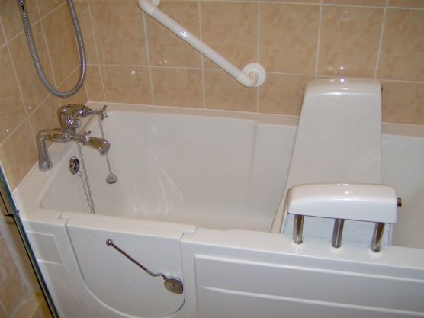
Quality-Adjusted Life Years
Q = Health-related quality of life
Commonly assessed using EQ-5D
L = survival duration
QALY = Q x L

Slide 11
Limitations of QALYs
Narrow interpretation of health
Health interventions often have a broader impact (not assessed)
Does not capture our experience of receiving healthcare
We cannot always cure a condition, so focus may shift to helping the patient live with it as best as possible.
Not appropriate for evaluating public health & social care
Again, because too narrow

Slide 12
Health
Health is a state of complete physical, mental and social well-being and not merely the absence of disease or infirmity

Slide 13
Three approaches:
OCAP/OxCAP/OxCAP-MH
Public health, including mental health
ICECAP-A, ICECAP-O, ICECAP-SCM
Health and social care in adults, older people and at the end of life
Assessing capability in patients with chronic pain

Slide 14
Expansionist interpretations
Expert-led versus participatory
Based upon Nussbaum’s 10 central capabilities
Developed through in-depth qualitative work
Combinations of attribute phrasing (functioning versus capability)

Slide 15
Participatory approaches
Chronic Pain
ICECAP-O
Love & social inclusion
Enjoyment
Respect & identity
Remaining physically & mentally active
Societal & family roles
Independence & autonomy
Physical & mental wellbeing
Feeling secure about the future
Attachment (love & friendship)
Security (thinking about the future without concern)
Role (doing things which make you feel valued)
Enjoyment (enjoyment & pleasure)
Control (being independent)

Slide 16
Expert led approach
Love & social support
Social networks
Enjoy recreation
Appreciate nature
Respect & appreciation
Discrimination
Freedom of expression
Employment Discrimination
Imagination & creativity
Daily activities
Influence local decisions
Planning one’s life
Suitable accommodation
Life expectancy
Losing sleep
Property Ownership
Neighbourhood safety
Potential for assault
Notes:
Nussbaum’s 10 Central Capabilities

Slide 17
Expansionist interpretations
Valuation versus equal weights
Multi-attribute Valuation (Swing-Weighting) - exploratory
Best-worst scaling
Equal weights
Loosely assumes a cost-consequence type framework (costs and outcomes disaggregated)

Slide 18
QALYs versus UK (expansionist) approaches
Budget
Health system
Impact
Health functioning
Compensation
No scope for wellbeing to be increased in other ways
Budget
Any sector
Impact
Broad capability set (incl. Health?)
Compensation
Health one contributor to wellbeing

Slide 19
Observation/Critique
OxCAP instruments likely to be used alongside EQ-5D
Capture additional evidence for decision-makers to consider
ICECAP instruments typically used alongside EQ-5D in practice
Evidence that the two instruments capture different things
What about health in a more immediate clinical sense?

Slide 20
Observation/Critique
Does inclusion alongside EQ-5D in a cost-consequence type analysis represent the ‘easy option’ or perhaps a lack of consideration of how capability theory can appropriately shape the decision-making framework?
What about a decision-rule??

Slide 21
Decision-Making - Mitchell (2013)
Adoption of an approach based on AF multidimensional poverty measures
Sufficient capability
Notes:
Used to re-scale existing values

Slide 22
Health capability

Slide 23
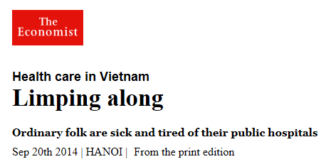
Focus on health: Ruger’s Health Capability Paradigm
“a lack of consensus on moral norms relating to distributive justice”
(Ruger, 2010, p14)

Slide 24
Health Capability Paradigm
Health Capability
Health Agency
Avoidable mortality
Avoidable morbidity
Health functioning
Assessed using (mostly) existing measures – such as SF-36
Health knowledge
Extent to which individuals are able to make informed decisions
No place for preferences as preferences may not align with health need
Notes:
e.g. devaluation of women diminishing preferences for maternal health during and after pregnancy

Slide 25
Observation/Critique
Extends what is incorporated into QALYs by considering health agency in addition to health capability (or health functioning).
By incorporating information about preventative interventions, health guidance/advice and access to services it encompasses many public health type objectives
But how to assess health knowledge/health agency is not clearly specified.
Notes:
Trade-off between HC & HA + inclusion in decision-making, other demands on health budget?

Slide 26
QALYs versus Health Capability
Budget
Health system
Impact
Health functioning
Compensation
No scope for wellbeing to be increased in other ways
Budget
Any sector
Impact
Health functioning
& Health agency
Compensation
No scope for wellbeing to be increased in other ways

Slide 27
Short-fall sufficiency
Used to determine need/priority
“…priority goes to individuals who exhibit a gap between their health status and the status they could achieve, and those with the greatest deficit in health status should receive the highest priority. Priority is placed on all deprivations below the shortfall equity norm”
Ruger (2009, p269)

Slide 28
Allocation of resources: Step I (who to prioritise)
Health capabilities selected on basis they will attract widespread support across society as an absolute minimal acceptable threshold.
Absolute constraint on redistribution is point at which additional redistribution requires an individual to sacrifice central health capabilities
Redistribution will therefore occur in some range within which sacrifice can be made outside the realm of central health capabilities

Slide 29
Allocation of resources: Step II (how best to intervene)
Assessment of efficiency using cost-effectiveness analysis

Slide 30
Practicalities of adopting SFS
Instruments such as SF-36 not developed to reflect any form of consensus as to central aspects of health.
Nor is it apparent that having any form of deficiency in terms of SF-36 should trigger state support.
E.g. having some limitations in terms of strenuous sports and heavy lifting.
So how do we set the cut-off point for SFS? Requires a value judgement.
Notes:
is unlikely to be accepted as objective global indicator of escapable morbidity

Slide 31
Shortfall sufficiency
A closer look…

Slide 32
Policy implications of adopting SFS
Current QALY framework (in the UK and elsewhere):
New health interventions evaluated in terms of efficiency
Maximisation of health across the system
Younger patients and those better able to benefit from treatment likely to be prioritised.
Treatments may be effective because they prevent future health problems and/or reduce future costs (albeit these will be discounted)
Little attention given to appropriate/necessary
disinvestment

Slide 33
Policy implications of adopting SFS
A future with SFS
Identification of patient groups (and/or condition types) to be prioritised
Pharmaceutical research follows trends in terms of where short-falls are identified?
Less focus on treatments which enhance health in controversial clinical areas (where that benefit may be deemed futile)?
Could result in greater allocation of resources to rare (orphan) diseases with smaller proportions of population receiving healthcare spending?
Could favour costly curative treatments over cost-saving preventative interventions?

Slide 34
discussion

Slide 35
Discussion
Capability approach underspecified: will naturally have differences in interpretation
“Expansionist” interpretations motivated by a desire to capture broader benefits of health and social care and enable the evaluation of ‘joined up’ health and social care services
Health Capability Paradigm motivated by a lack of consensus on moral norms relating to distributive justice
seeks to facilitate agreement on a core concept of health which expands beyond simply health functioning

Slide 36
For the future
Need to give greater consideration to health itself in expansionist approaches
(is there a problem with double counting?)
Need to have clear guidance as to how to assess health agency in the Health Capability Paradigm
Interpretations of capability will differ
all that researchers can do is ensure a good understanding of the motivating principles behind capability and work in accordance with these

Slide 37
For the future: jam for the few or the many?
We need to fully understand the methodological and policy implications of adopting SFS as well as fully exploring possible alternatives.
SFS could result in significantly different allocations of resources in countries such as the UK

Slide 38
Thank you. Any questions?
P.Kinghorn@bham.ac.uk
@philkinghorn

